Slide 1
Fiber Optics Communications

Slide 2
Topics
Fiber Materials
Fiber Manufactoring

Slide 3
Fiber Materials
Requirements for optical fiber material
  It must be possible to make long thin, flexible fibers from the material
  Material must be transparent at a particular optical wave length in order for fiber to guide light efficiently
  Physically compatible materials that have slightly different refractive indices for core and cladding must be available

Slide 4
Fiber Materials
Materials that satisfy these requirements are glasses and plastic
Majority of fibers are made of glass consisting of either silica or silicate.
Plastic fibers are less widely used because of their higher attenuation
Plastic fibers are used for short distance applications (several hundred meters) and abusive environments

Slide 5
Glass Fiber
Glass is made by fusing mixture of metal oxides, sulfides, or selenides. The resulting material is a randomly connected molecular network rather a well defined structure as found in crystalline materials
A consequence of this random order is glass does not have a well defined melting point
When glass is heated , it gradually begins to soften until it becomes a viscous liquid

Slide 6
Glass Fiber
Optical fiber are made from oxide glasses and most popular is silica (SiO2) which has refractive index of 1.458 at 850 nm.
To produce two similar materials with slightly different refraction indices for core and cladding, either fluorine or other oxides (dopants) are added to silica

Slide 7
Glass Fiber
Sand is the principle raw material for silica
Glass composed of pure silica is referred to as either silica glass, fused glass, or vitreous silica.
Desired properties are
  resistance to deformation at temperatures as high as 1000 C
  High resistance to breakage from thermal shock
  Good chemical durability
  High transparency in both visible and infrared regions of interest

Slide 8
Plastic Optical Fibers
Growing demand for delivering high-speed services to workstations
Have greater optical signal attenuations than glass fiber
They tough and durable
Core diameter is 10-20 times larger

Slide 9
Fiber Fabrication
Two basic techniques
  Vapor-phase oxidation process
    Outside vapor phase oxidation
    Vapor phase axial deposition
    Modified chemical vapor deposition
  Direct-melt methods

Slide 10
Fiber Fabrication
Direct melt method
  Follows traditional glass making procedures
  Optical fiber are made directly from molten state of purified components of silicate glass
Vapor phase oxidation
  Highly pure vapors of metal galides (SiCl4) react with oxygen to form white powder of SiO2 particles
  Particles are collected on surface of bulk glass by above methods and are transformed to a homogenous glass by heating without melting to form a clear glass rod or tube. This rod is called preform
  Preform is 10-25 mm in diameter and 60-120 cm long.

Slide 11
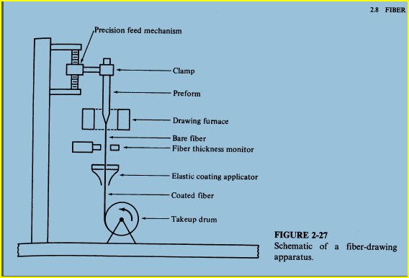

Slide 12
Fabrication
  Prefrom is fed into circular heater called drawing furnace.
  Preform end is softened to the point where it can be drawn into a very thin filament which becomes optical fiber
  The speed of the drum at the bottom of draw tower determines how fast and in turn how thick the fiber is
  An elastic coating is applied to protect the fiber

Slide 13
Outside Vapor Phase Oxidation
Core layer is deposited on a rotating ceramic rod
Cladding is deposited on top of core layer
Ceramic rod is slipped out (different thermal expansion coefficient)
The tube is heated and mounted in a fiber drawing tower and made into a fiber
The central hole collapses during this drawing process

Slide 14
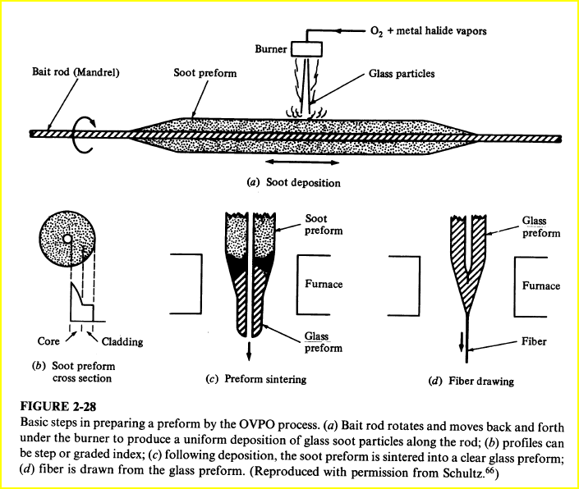

Slide 15
Vapor Phase Axial Deposition
Similar to outside vapor deposition
Starts with a seed which is a pure silica rod
The preform is grown in the axial direction by moving rod upward
Rod is also rotated to maintain cylindrical symmetery
As preform moves upward it is transformed into a solid transparent rod preform by zone melting (heating in a narrow localized zone)
Advantages
  No central hole

Slide 16
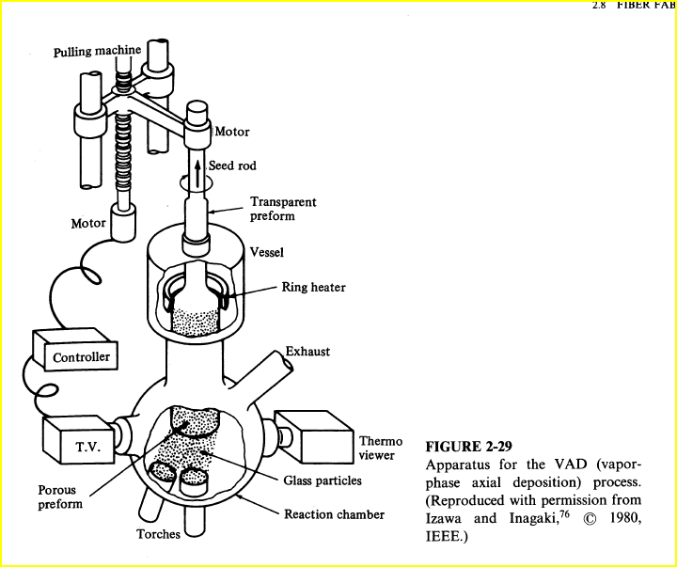

Slide 17
Modified Chemical Vapor Deposition
Pioneered at Bell Labs, and adopted to produce low loss graded index fiber
Glass vapor particles, arising from reaction of constituent metal halide gasses and oxygen flow through inside of revolving silica tube
As SiO2 particles are deposited, they are sintered to a clear glass layer by an oxyhydrogen torch which travels back and forth
When desired thickness of glass have been deposited, vapor flow is shut off
Tube is heated strongly to cause it to collapse into a solid rod prefrom
Fiber drawn from this prefrom rod will have a core that consists of vapor deposited material and a cladding that consists of original silica tube.

Slide 18
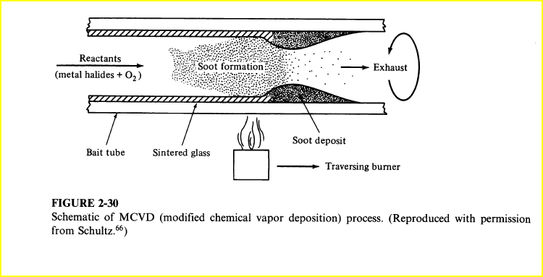

Slide 19
Double Crucible Method
Silica and halide glass fiber can all be made using a direct-melt double crucible technique
Glass rods for the core and cladding materials are first made separately by melting mixtures of purified powders
These rods are then used as feedstock for each of two concentric crucibles
Advantage of this method is being a continuous process
Careful attention must be paid to avoid contaminants during metling

